Slide 1


The Traveller Bulgaria
A Java Web Application Project
by David and Yassen
ITTalents Training Camp Season 6

Slide 2
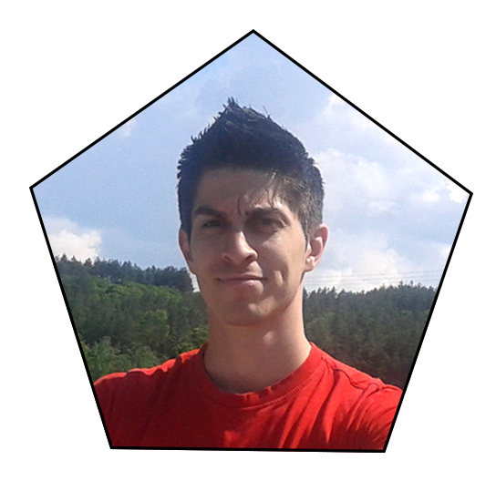
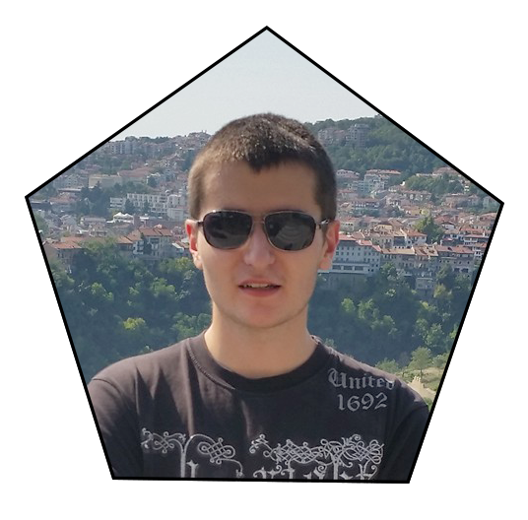
Who are we?
- We are Yassen and David and we are young people with the passion to turn our creative and inspiring ideas into amazing real projects! We are currently working on our Travelling Social Media which is a unique product for the Bulgarian community and can offer an incredible user experience for people who like to travel!

Slide 3
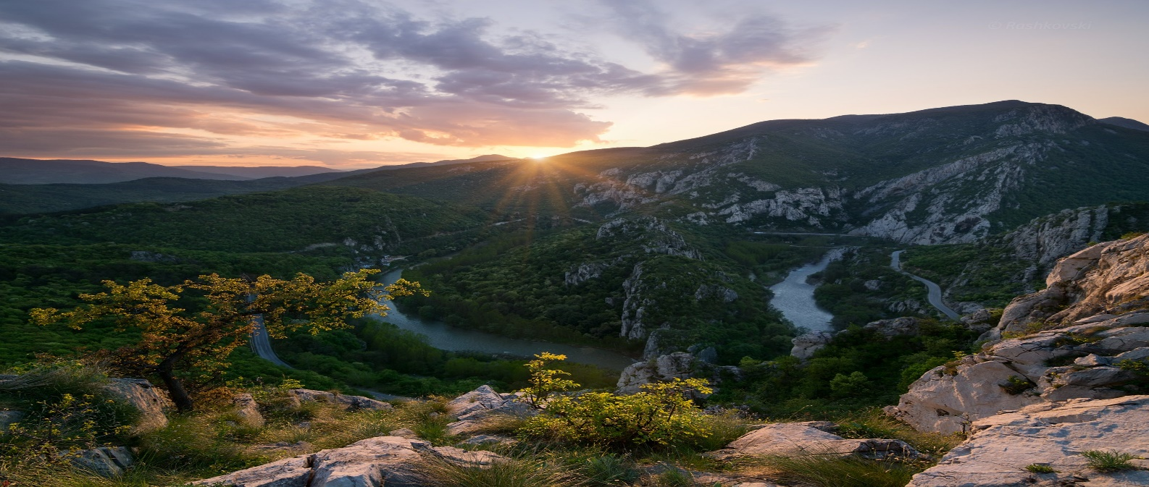
What did we do?
We developed a Social Media Site for travelers in Bulgaria which combines the functionality of a social media and the convenience of a Traveler’s guide!
Our project is called The Traveller Bulgaria.

Slide 4
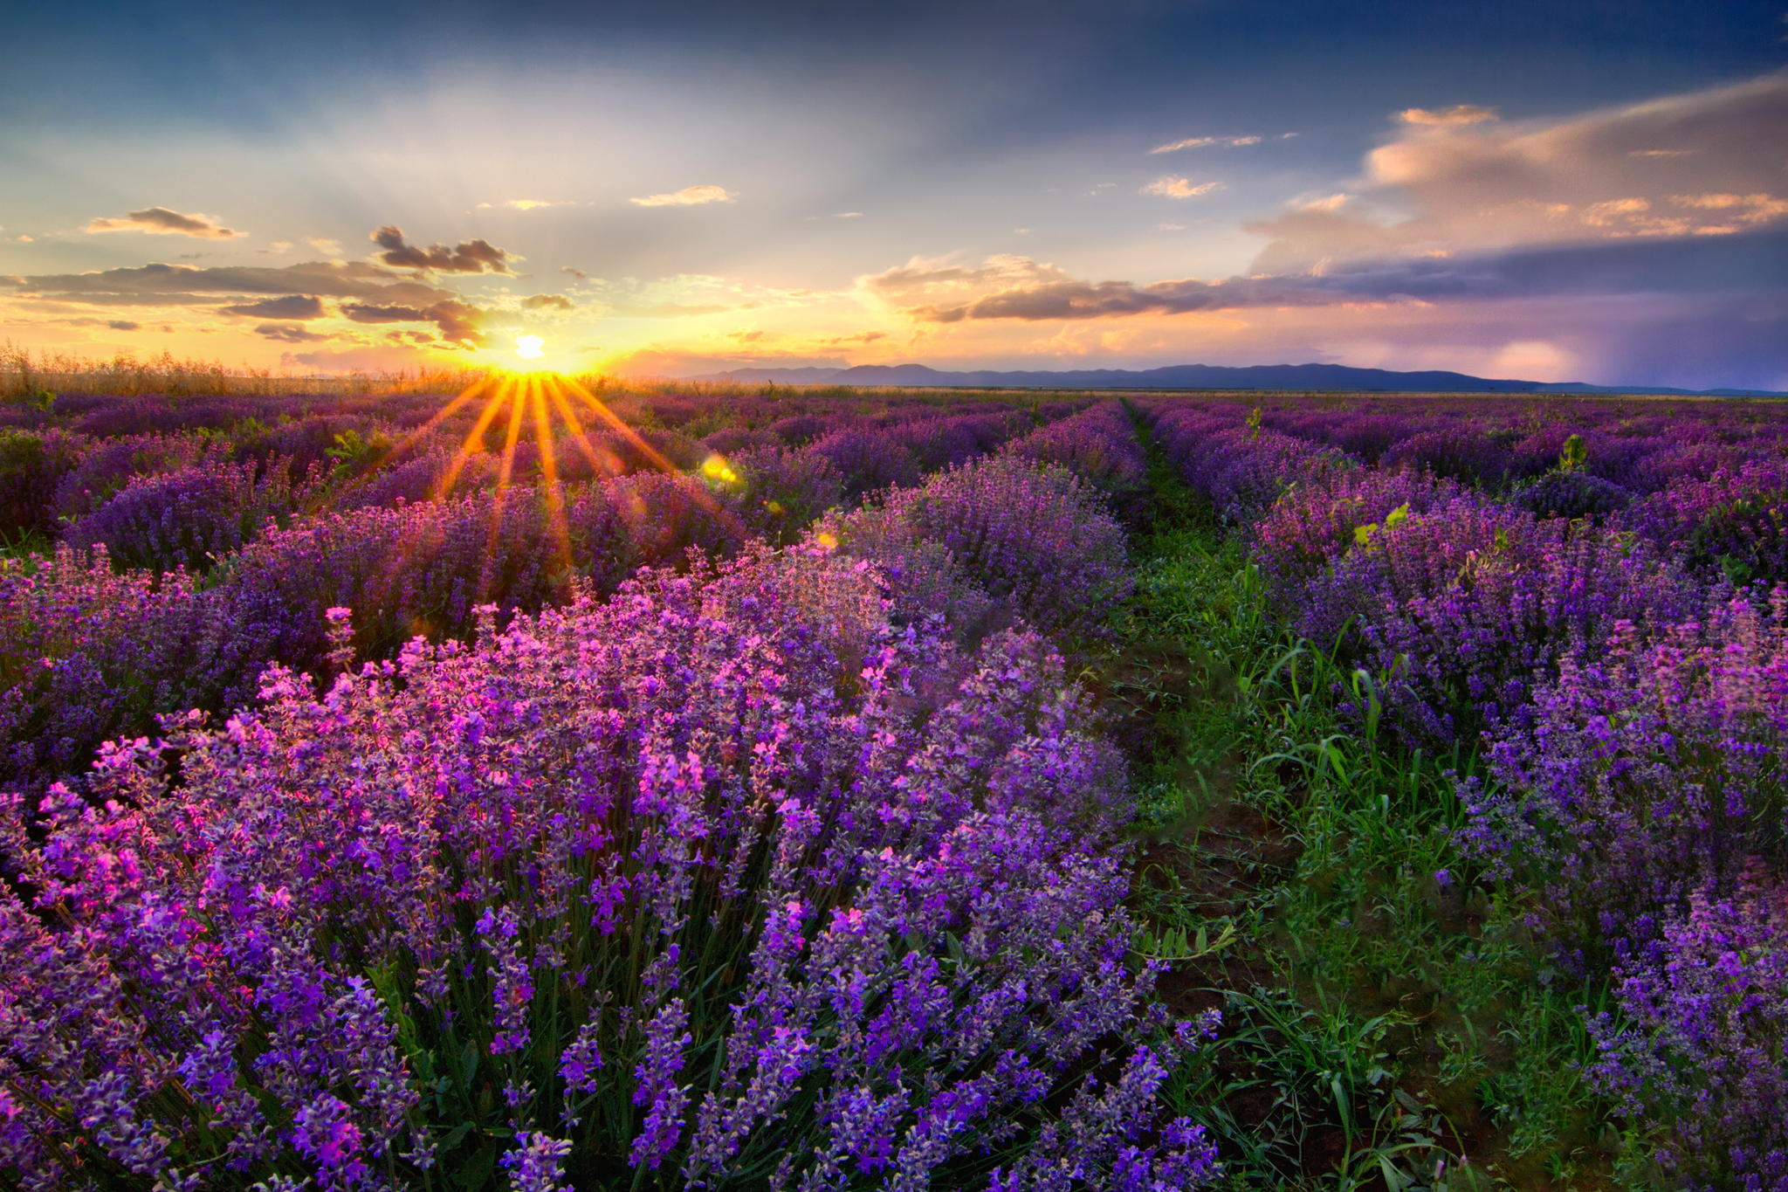
What does it do?
- The idea of the Site is to help people with similar travel interests socialize over their favorite hobby – exploring Bulgaria, and find new friends to travel with.
The targeted clients are people who like to travel, share their experience with others over the Internet, as well as see where other users are going on vacations and how they are spending their time on the go!

Slide 5
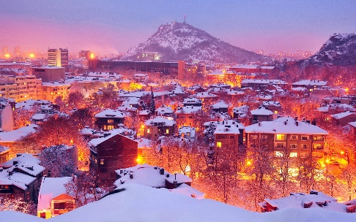
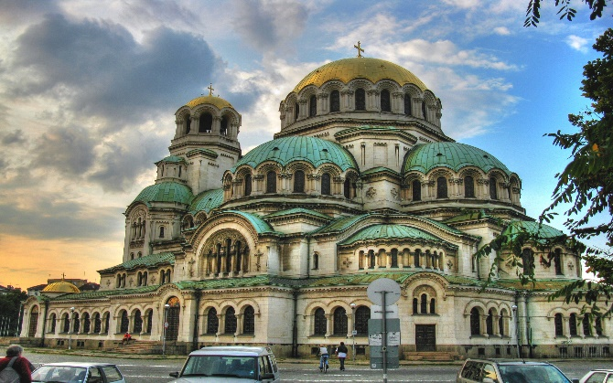
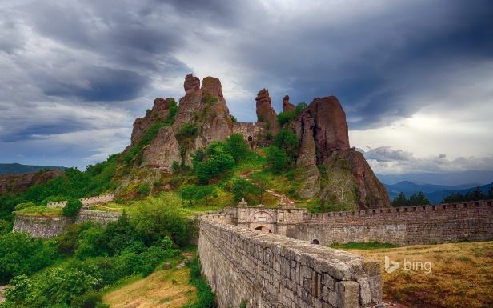
What does it do?
Current project functionality:
Registering as a user with a name, personal information and a profile picture; Logging In and Out;
Adding destinations with name, description with personal experience, coordinates on the map (as well as auto-generating them) and a picture;
Going through all the destinations added by the users;
Commenting on a destination;

Slide 6
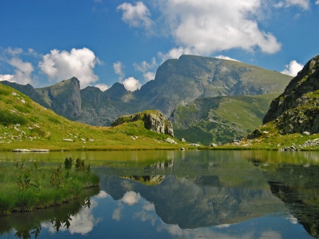
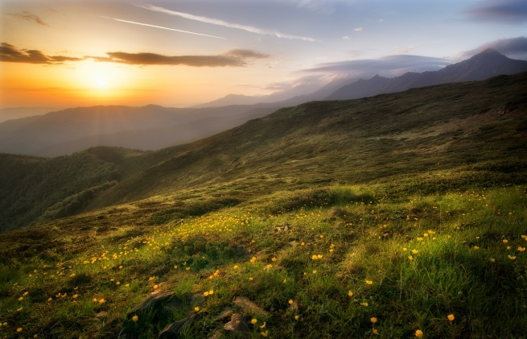
What technologies does it use?
Java (Back-End support and business logic of the Project)
Apache Tomcat (Application Server)
Servlets (providing the general framework for services built on the request-response paradigm and acting as controllers in the Web Application)
HTML/CSS/JavaScript (supporting the Front-End of the Site and defining the visual design and style presented to the client)
Google maps API (included in the pages with destinations for visual and practical purposes)
JSPs (adding to the visual representation of the Site and generating dynamic content)
MySQL (Database; preserving the data of the Project’s content)
JDBC (connecting to the Database)

Slide 7
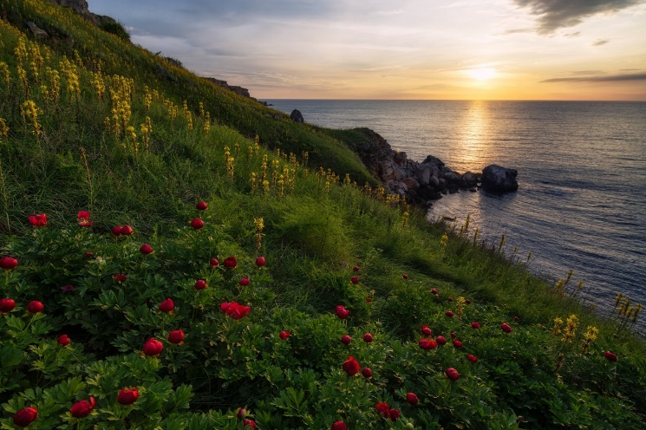
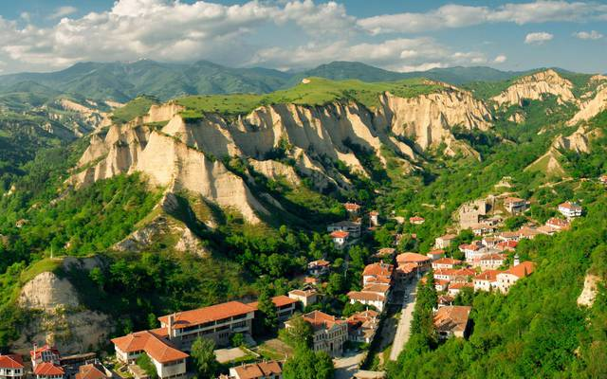
Future plans?
We intend on developing the project even further by adding more features such as:
“Like” button for users, destinations and comments;
Adding people to “Friends List”;
Messaging other users in “Private conversations”;
Adding bonus content to the destinations like nearby restaurants, sights, parks, available activities, hotels and places to sleep, camping sites, sporting opportunities, transport etc., and including additional information such as expenses, useful information, transport fees and schedules, and more;
Rating users and destinations;
Filtering and searching for users and destinations;
Adding other users’ destinations to the list of visited destinations;
Logging in from other social networks and sharing posts from our Site;
Bulgarian translation of the whole Website;
And many, many more!

Slide 8
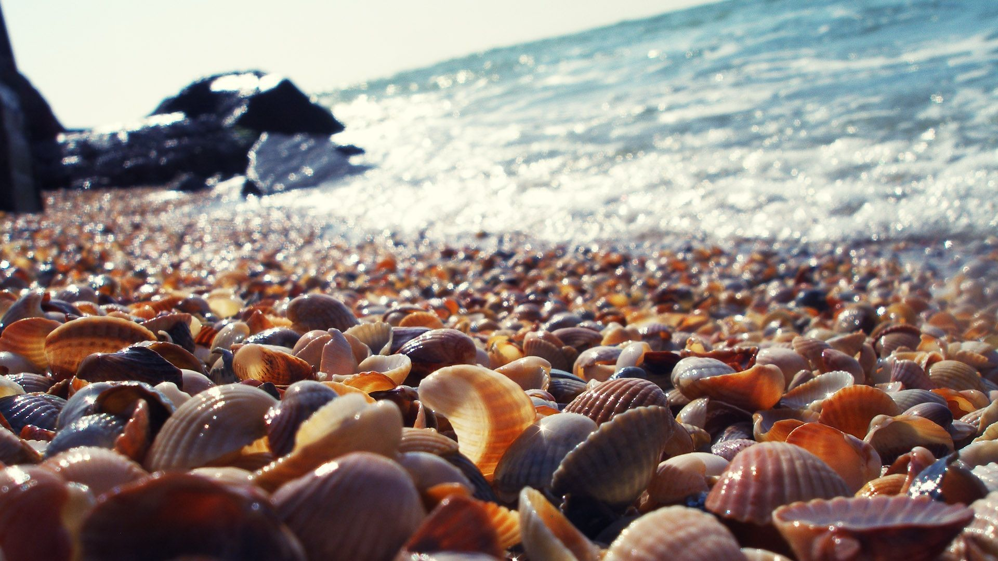
Demo
- But enough talking! Let’s get to the action!

